Slide 1
This page is blank

Slide 2

INTRODUCTION & OVERVIEW
What is data?
What is a data center?

Slide 3
What Data is
“Data is the organised of information. This information may
be in the form of text documents, images, audio clips,
software programs, or other types of data. Computer data
may be processed by the computer's CPU and is stored in
files and folders on the computer's hard disk.”

Slide 4
What a Data Center Is
Data centers are simply centralized locations where computing and networking equipment is concentrated for the purpose of collecting, storing, processing, distributing and allowing access to large amounts of data.
COMPUTING RESOURCES IN A DATA CENTER
Mainframes
web and application Servers
file and print servers
Messaging Servers
Application S/W & OS Running them
Storage Subsystems
Network Infrastructure
IP or storage-area network (SAN)

Slide 5
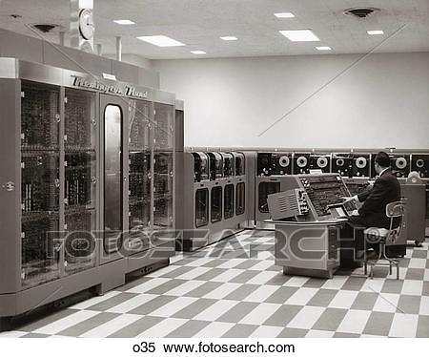
History of data centers
Eniac was the first datacenter.
Complexity of earlier computer
These computers had Overheating issues
Establishment of these data centers were Highly expensive.
Hence Used for only military applications in the beginning.
The boom of data centers came during the dot-com bubble of 1997–2000

Slide 6
Data Center Facilities
Power capacity
Cooling capacity
Cabling
Temperature and humidity controls
Fire and smoke systems
Physical security: restricted access and surveillance systems
Rack space and raised floors

Slide 7
Applications of Data center
Email and file sharing
Customer relationship management(CMR)
Retail Industry
Banking Sector
E-commerce

Slide 8
APPLICATION IN INTERPRISES
Enterprise applications typically focus on one of the following major business areas:
Customer relationship management (CRM)
Enterprise resource planning (ERP)
Supply chain management (SCM)
Sales force automation (SFA)
Order processing
E-commerce

Slide 9
Advantages of a data center.
Secure processing of data.
Structuring of large amount of data.
Easy access to data from anywhere.
Flexible and smooth operations.
Why should we use a data center?

Slide 10
DATA CENTER SERVICES OR FUNCTIONS
Infrastructure services
Routing
Switching
Application services
Load Balancing
Security services
Fibre Channel Switching
intrusion detection
Storage services
Secure Socket Layer Offloading
Packet filtering and inspection,
SAN Architecture
Server-farm Architecture
Caching
Intrusion prevention
Backup & Archival
SAN Extension
Business continuance
Site Selection
Data Center interconnecti-vity

Slide 11
DESIGN CRITERIA
Availability
Scalability
Security
Performance
Manageability

Slide 12
Data Center in Enterprises
Campus Network
Internal Server Farm
Internet Server Farm
Private Wan
Remote Access
External Server Farm

Slide 13
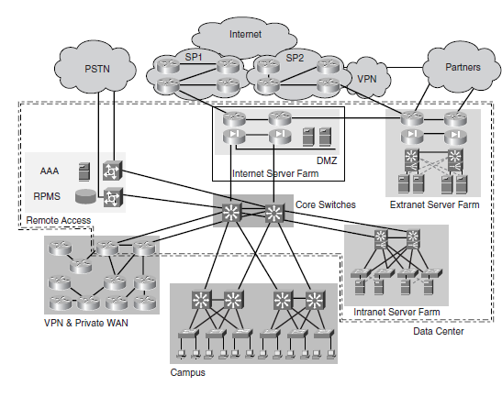

Slide 14

Application Architecture Models

Slide 15
Application Architecture Models
The Client/Server Model
The n-Tier Model
Multitier Architecture Application Environment

Slide 16
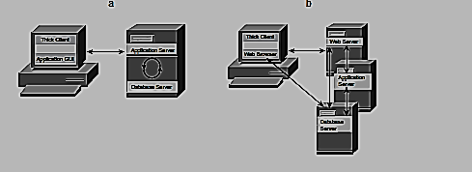
Client/Server Model and Its Evolution
The classic client/server model describes the communication between an application and a user through the use of a server and a client. The classic client/server model consists of thefollowing:
A thick client that provides a graphical user interface (GUI) on top of an application or business logic where some processing occurs
A server where the remaining business logic resides

Slide 17
The n-Tier Model
The n-tier model uses a
thin client and a web browser to access the data in many different ways. The server side of the n-tier model is divided into distinct functional areas that include the web, application, and database server.

Slide 18
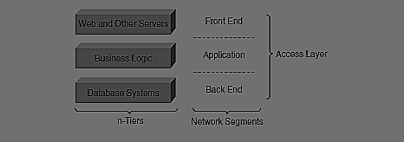
Multitier Architecture Application Environment
Multitier architectures refer to the Data Center server farms supporting applications that
provide a logical and physical separation between various application functions, such as
web, application, and database (n-tier model). The network architecture is then dictated by
the requirements of applications in use and their specific availability, scalability, and security
and management goals.

Slide 19
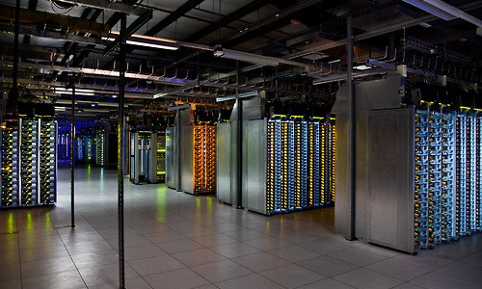
Data Center Architecture

Slide 20
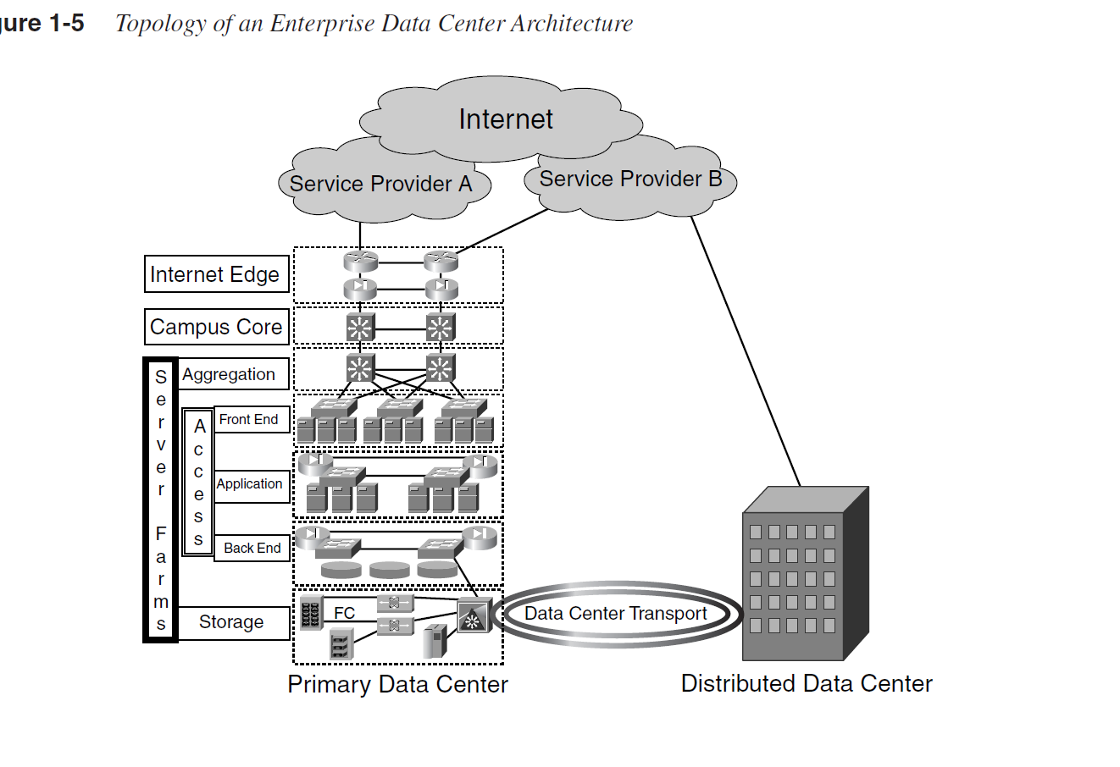
Data Center Architecture
The enterprise Data Center architecture is inclusive of many functional areas, as presented earlier . The focus of this section is the architecture of a generic enterprise Data Center connected to the Internet and supporting an intranet server farm. Other types of server farms, “Data Center Design Overview,” follow the same architecture used for intranet server farms yet with different scalability, security, and management requirements.

Slide 21
The Internet Edge provides the connectivity from the enterprise to the Internet and its
associated redundancy and security functions, such as the following:
• Redundant connections to different service providers
• External and internal routing through exterior border gateway protocol (EBGP) and
interior border gateway protocol (IBGP)
• Edge security to control access from the Internet
• Control for access to the Internet from the enterprise clients
The campus core switches provide connectivity between the Internet Edge, the intranet
server farms, the campus network, and the private WAN. The core switches physically
connect to the devices that provide access to other major network areas, such as the private
WAN edge routers, the server-farm aggregation switches, and campus distribution
switches.

Slide 22
Aggregation Layer
The aggregation layer is the aggregation point for devices that provide services to all server
farms. These devices are multilayer switches, firewalls, load balancers, and other devices
that typically support services across all servers. The multilayer switches are referred to as
aggregation switches because of the aggregation function they perform. Service devices are
shared by all server farms.

Slide 23
Access Layer
Front-End Segment
Application Segment
Back-End Segment

Slide 24
Front-End Segment
The front-end segment consists of Layer 2 switches, security devices or features, and the
front-end server farms.
The front-end segment is analogous to
the traditional access layer of the hierarchical campus network design and provides the
same functionality.
The front-end server farms typically include
FTP
Telnet
Simple Mail Transfer Protocol (SMTP)
TN3270 (mainframe terminals)
web servers
DNS servers
business application servers
network-based applicationservers such as IP television (IPTV) broadcast servers
IP telephony call managers

Slide 25
Application Segment
The application segment has the same network infrastructure components as the front-end segment and the application servers. The features required by the application segment are almost identical to those needed in the front-end segment, albeit with additional security.
Back-End Segment
The back-end segment is the same as the previous two segments except that it supports the connectivity to database servers. The back-end segment features are almost identical to those at the application segment, yet the security considerations are more stringent and aim at protecting the data, critical or not.

Slide 27
Storage Layer
The storage layer consists of the storage infrastructure such as Fibre Channel switches and
routers that support small computer system interface (SCSI) over IP (iSCSI) or Fibre
Channel over IP (FCIP). Storage network devices provide the connectivity to servers,
storage devices such as disk subsystems, and tape subsystems
Data Center Transport Layer
The Data Center transport layer includes the transport technologies required for the
following purposes:
• Communication between distributed Data Centers for rerouting client-to-server traffic
• Communication between distributed server farms located in distributed Data Centers
for the purposes of remote mirroring, replication, or clustering

Slide 28
Storage and Transport Layers

Slide 29
DATA CENTER SERVICES
IP Infrastructure services
Routing
Switching
Application services
Load Balancing
Security services
Fibre Channel Switching
intrusion detection
Storage services
Secure Socket Layer Offloading
Packet filtering and inspection,
SAN Architecture
Server-farm Architecture
Caching
Intrusion prevention
Backup & Archival
SAN Extension
Business continuance
Site Selection
Data Center interconnecti-vity

Slide 30
IP Infrastructure Services
Infrastructure services include all core features needed for the Data Center IP infrastructure to function and serve as the foundation,
along with the storage infrastructure, of all other Data Center
services. The IP infrastructure features are organized as follows:
• Layer 2
• Layer 3
• Intelligent Network Services

Slide 31
Application Services
Application services include a number of features that enhance the network awareness of applications and use network intelligence to optimize application environments.
These features are equally available to scale server-farm performance, to perform
packet inspection at Layer 4 or Layer 5, and to improve server response time.
The server-farm features are organized by the devices that support them.
The following is a list of those features:
• Load balancing
• Caching
• SSL termination
Load balancers perform two core functions:
• Scale and distribute the load to server farms
• Track server health to ensure high availability

Slide 32
Security Services
Security services include the features and technologies used to secure the Data Center infrastructure and application environments. Given the variety of likely targets in the Data Center, it is important to use a systems
approach to securing the Data Center. This comprehensive approach
considers the use of all possible security tools in addition to hardening
every network device and using a secure management infrastructure. The security tools and features are as follows:
• Access control lists (ACLs)
• Firewalls
• IDSs and host IDSs
• Secure management
• Layer 2 and Layer 3 security features

Slide 33
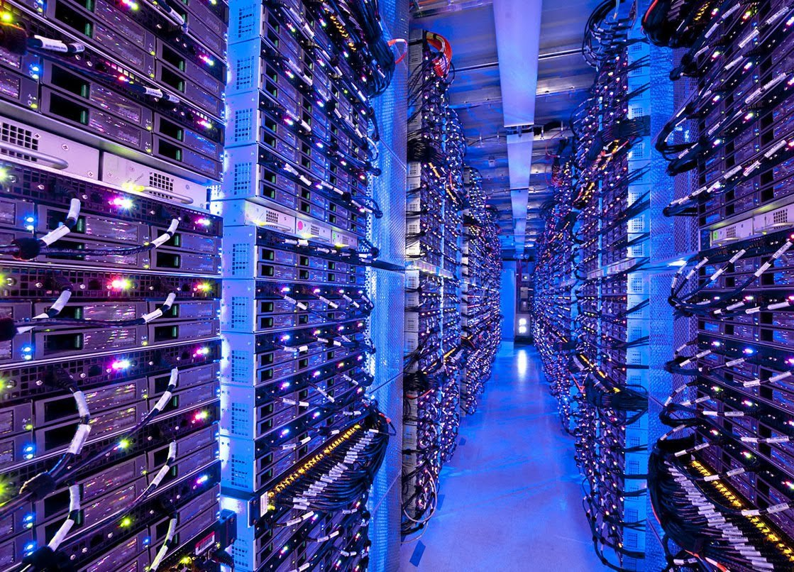
Storage Services
Storage services include the capability of consolidating direct attached disks by using disk
arrays that are connected to the network. This setup provides a more effective disk utilization
mechanism and allows the centralization of storage management. Two additional services
are the capability of consolidating multiple isolated SANs on to the same larger SAN
and the virtualization of storage so that multiple servers concurrently use the same set of
disk arrays.

Slide 34
Business Continuance Infrastructure Services
Business continuance infrastructure services support the highest levels of application
availability through the use of networking technology in the three major areas described
next.
• Site selection
• SAN extension
• Data Center interconnectivity
Site selection refers to the features that allow the automatic detection of the failure of a Data
Center on the application level and the subsequent reroute of all requests to an available site
and server farm. You can use the technology for site selection over the Internet or the
intranet. The mechanisms for site selection vary from the use of DNS to the host routes and the routed network.

Slide 35
Cryptography
Cryptography provides confidentiality, integrity, authentication, antireplay protection, and nonrepudiation. Data Centers use cryptographic services with
two primary purposes: maintaining the privacy of the users’ data in storage
or during transfer over the network and securing the management communications. Cryptographic algorithms are categorized based on the key
model they use.
Algorithms that use the same single key for encryption and decryption
are called symmetric or secret-key algorithms
Algorithms that use a private public-key pair are called asymmetric or public-key algorithms.

Slide 36
Symmetric Cryptography
This section provides basic information about the most popular symmetric algorithms and
compares them based on strength and speed. Both parameters change with the evolution
of the computer processing power, but the relative strength and speed of the algorithms
does not change.
When comparing symmetric algorithms, you can understand the performance if you know
whether the cipher is a block cipher or stream cipher. Stream ciphers tend to be faster than
block ciphers.
Block ciphers operate on fixed-length blocks of plaintext; for example, with DES, they are
64-bit chunks.
Stream ciphers operate on smaller plaintext units (typically bit-by-bit). RC4 is a stream
cipher. Most of today’s e-commerce applications use RC4 for bulk encryption.
DES and its variation 3DES are block ciphers, and they are among the most widely deployed
symmetric algorithms. DES is no longer considered secure, which is why financial
institutions use 3DES for bulk encryption.
The AES algorithm is a block cipher. It is stronger than 3DES and is being adopted by most
secure transport protocols, such as IPSec, SSL, and Secure Shell (SSH).

Slide 37
Digital Encryption Standard (DES)
DES is a symmetric algorithm originally developed by IBM and the National Security
Agency (NSA). It was adopted by the U.S. Government as a federal encryption standard
in 1977. The DES specifications are available in the Federal Information Processing
Standards (FIPS) publication 46-3.

Slide 38
Triple DES (3DES)
3DES is a variation of DES. Depending on how 3DES is configured, its strength is equivalent
to the use of a key of 112 bits (3DES 2-key) or 168 bits (3DES 3-key). Like DES, 3DES is
an algorithm approved for use by the U.S. Government.
3DES applies three times the same DES algorithm to the plaintext, using two or three
different keys. Figure illustrates how 3DES works.

Slide 39
Asymmetric Cryptography
Asymmetric cryptography (also called public-key cryptography).
It was first introduced by Diffie and Hellman in 1976.
It includes a number of encryption schemes that rely on a pair of keys, called the public key and the private key.
The public key is published and well known to every entity in the cryptosystem, but the private key is kept secret.
One can use public-key encryption to provide authentication, confidentiality, integrity,
antireplay protection, and nonrepudiation.
Public-key encryption is slower than secret-key cryptography, so it is rarely used to provide confidentiality for a large amount of data.
The main advantage of public-key cryptography is that the key management is simplified
compared to symmetric algorithms.
For the reasons just described, public-key cryptography is used to encrypt small amounts
of data, for the exchange of session keys (the secret keys used for bulk encryption),
and fordigital signatures.

Slide 40
Summary
Data Centers are strategic components of an enterprise that house the critical assets of the
business: applications, data, and the computing infrastructure. The Data Center network is
vital to sustaining the normal operations of the business. The Data Center network architecture
is driven by business requirements.
The criteria that guide the design of a Data Center are availability, scalability, security,
performance, and manageability. The Data Center designs described in this book are based
on these principles.
The distinct services likely offered by the Data Center network include IP infrastructure
connectivity, SAN infrastructure connectivity, application optimizations, security, and
business continuance.
The IP infrastructure connectivity function refers to routing and switching. The SAN function
refers to the Fibre Channel fabric switching. The application optimization functions
include load balancing, caching, and SSL offloading. The security function refers to the use
of ACLs, firewalls, IDSs, and secure management. The business continuance function
refers to the use of site selection (IP based or DNS based), SAN extension, and Data Center
Interconnectivity.

